Slide 1
Introduction
Production of Monoclonal Antibodies

Slide 2
Introduction
Polyclonal vs monoclonal antibodies
Misdiagnosis using polyclonal antibodies
George Kohler won a Noble prize in discovery of Mab 1984
The principle of Mab prodution
Lab sessions during the cource
Applications of Mabs

Slide 3
polyclonal and monoclonal antibodies

Slide 5
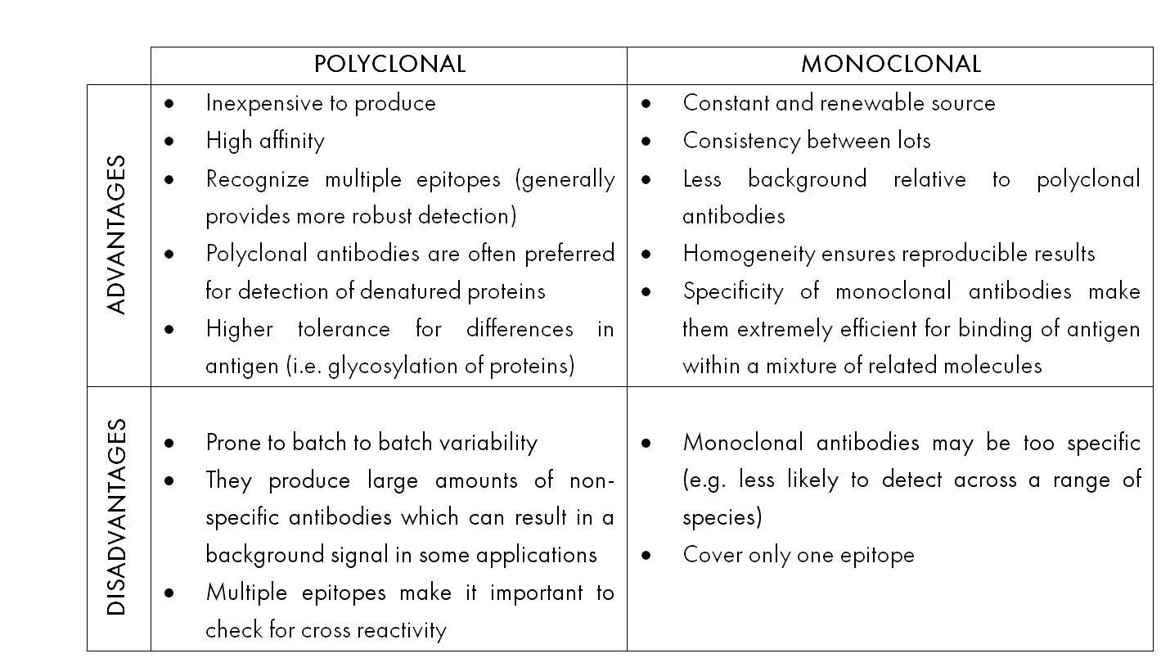

Slide 6
The principle of Mab production
Ag injection in a mouse --------specific B cells in spleen-----specific Abs in serum
Specific B cells + Myeloma cells (cancerous B cells)------Hybridoma cells
Hybridoma cell: immortal
Produce polyclonal abs
Cloning or separation of hybridoma cells so each hybridoma cell produce a Mab

Slide 7
Lab sessions
Immunisation of mice
Screening for Ab production by ELISA
Isolation of B cells from spleen of injected mice
Preparation of myeloma cells in tissue culture
Fusion of myeloma cells with the isolated B cells
Propagation of hybridoama cells in culture
Expansion of hybridoma cells
Cloning of hybridoma cells
Large scale production of Mabs
10. Characterization of Mabs: isotype determination
11. Characterization of Mabs: Titer determination

Slide 8
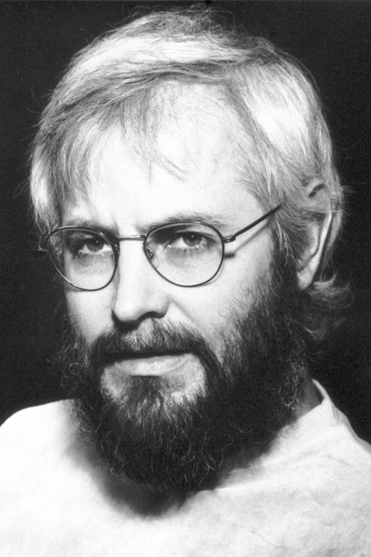
Georges J.F. Köhler
The Nobel Prize in Physiology or Medicine 1984
Born: 17 April 1946, Munich, Germany
Died: 1 March 1995, Freiburg im Breisgau, Germany
Affiliation at the time of the award: Basel Institute for Immunology, Basel, Switzerland
Prize motivation: "for the discovery of the principle for production of monoclonal antibodies."

Slide 9
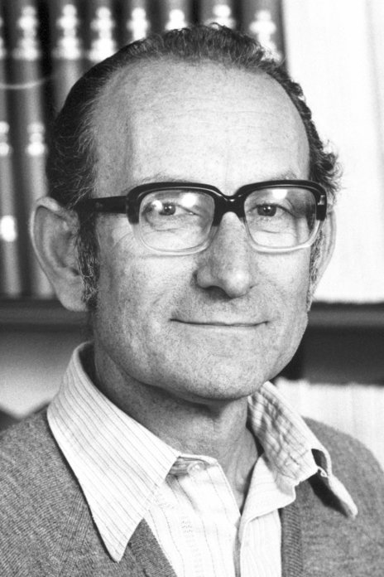
César Milstein
The Nobel Prize in Physiology or Medicine 1984
Born: 8 October 1927, Bahia Blanca, Argentina
Died: 24 March 2002, Cambridge, United Kingdom
Affiliation at the time of the award: MRC Laboratory of Molecular Biology, Cambridge, United Kingdom
Prize motivation: "for the discovery of the principle for production of monoclonal antibodies."

Slide 10
Applications of Mabs
The 3 types of applications are:
(1) Diagnostic Applications
(2) Therapeutic Applications
(3) Protein Purification and identification

Slide 11
Diagnostic application :
Diagnostic tests based on the use of MAbs as reagents are routinely used in radioimmunoassay (RIA) and enzyme-linked immunosorbent assays (ELISA) in the laboratory.
These assays measure the circulating concentrations of hormones (insulin, human chorionic gonadotropin, growth hormone, progesterone, thyroxine, triiodothyronine, thyroid stimulating hormone, gastrin, renin),
it is now possible to do the early diagnosis of the following conditions/diseases: pregnancy, cancer, hormonal disorders, infectious diseases, cardiovascular diseases (atherosclerosis, DVT, myocardial infarction, immunohistopathology and immunohaematopoietic malignancies

Slide 12
2. Therapeutic Applications:
Monoclonal antibodies have a wide range of therapeutic applications. MAbs are used in the treatment of cancer, transplantation of bone marrow and organs, autoimmune diseases, cardiovascular diseases and infectious diseases.
In 2018, a record number (12) of antibodies that treat a wide variety of diseases were granted a first approval in either the European Union (EU) or United States (US).

Slide 13
November 2018, 4 antibody therapeutics (sacituzumab govitecan, ravulizumab, risankizumab, romosozumab) were being considered for their first marketing approval in the EU or US.
Finally, approximately half (18 of 33) of the late-stage pipeline of antibody therapeutics for cancer are immune checkpoint modulators or antibody-drug conjugates are found. Of these, 7 are being evaluated in clinical studies with primary completion dates in late 2018 and in 2019
On October 14, 2020, FDA approved the triple antibody cocktail of atoltivimab, maftivimab, and odesivimab-ebgn (Inmazeb) for the treatment for Zaire ebolavirus (Ebola virus) infection in adult and pediatric patients. Atoltivimab, maftivimab, and odesivimab are IgG1 antibodies that bind glycoprotein on the surface of Ebola virus, thereby blocking attachment and entry of the virus into cells.

Slide 14
3. Protein Purification and identification:
Monoclonal antibodies can be produced for any protein. And the produced MAb can be conveniently used for the purification of the protein against which it was raised. MAbs columns can be prepared by coupling them to cyanogen bromide activated Sepharose (chromatographic matrix). The immobilized MAbs in this manner are very useful for the purification of proteins by immunoaffinity method.

Slide 15
Limitations for direct use of MAbs in cancer:
1. The MAbs produced in mice and directly used for therapeutic purposes may lead to the development of anti-mouse antibodies and hypersensitivity reactions.
2. All the cancer cells may not carry the same antigen for which MAb has been produced. Thus, MAbs may not be attached to some cancer cells at all.
3. The free antigens (of target cells) present in the circulation may bind to MAbs and prevent them from their action on the target cells.

